Slide 1
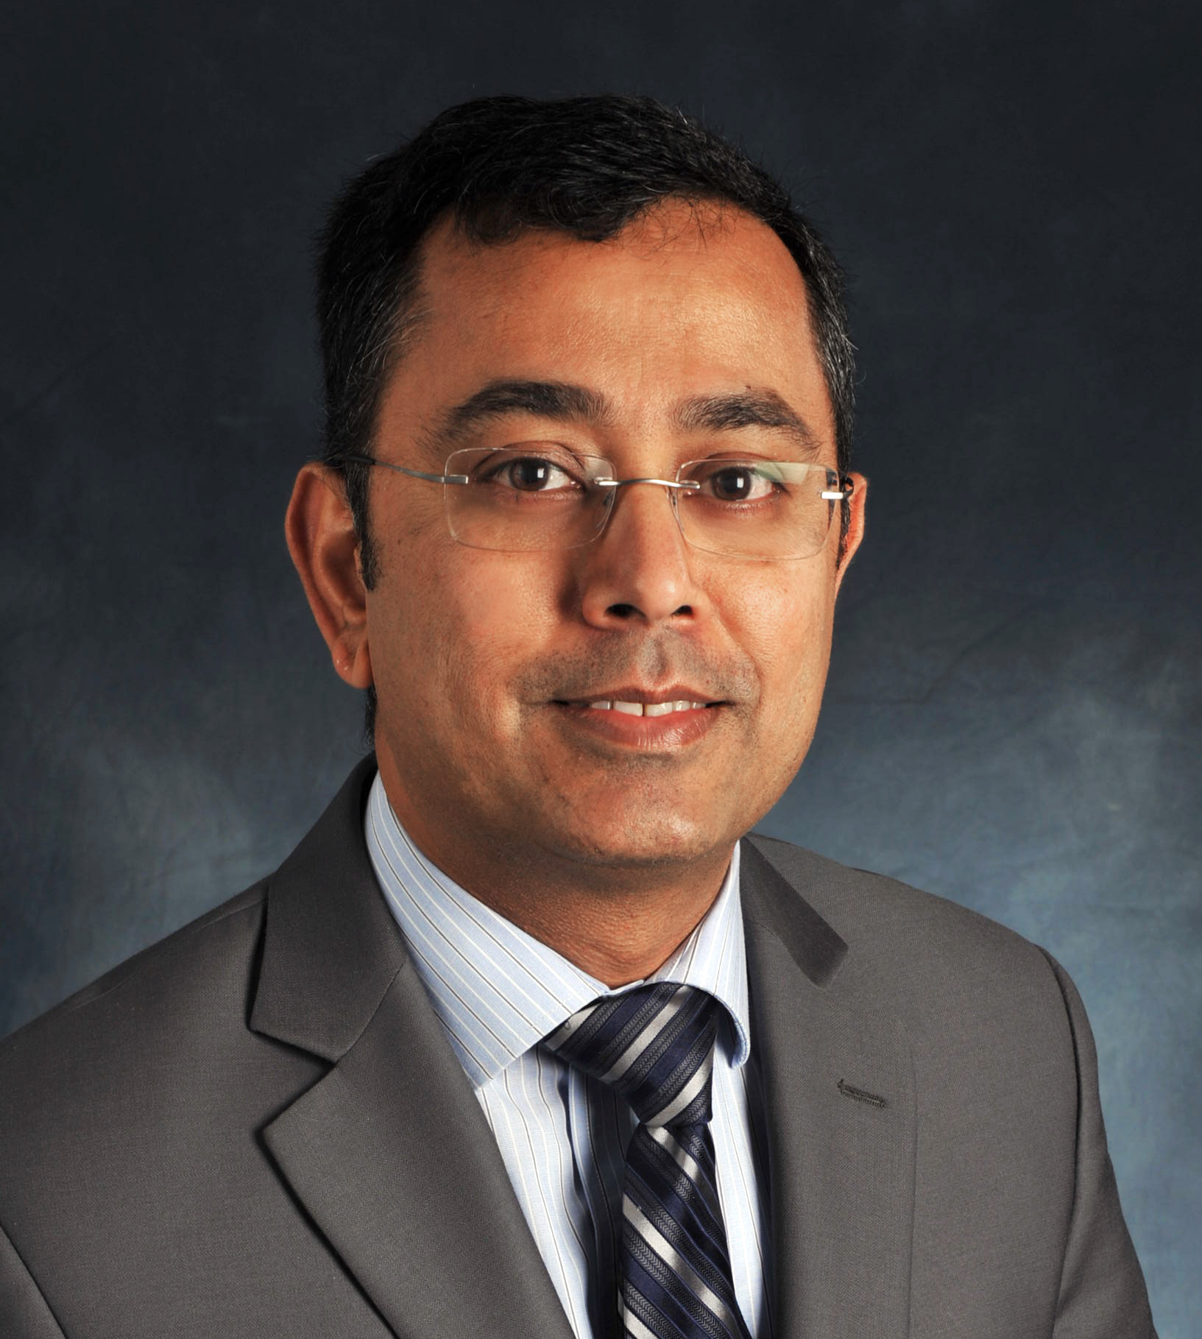
Our Second persona
Meet Charles –
➔ Experienced and licensed case worker
➔ Prioritizes safety and well-being of the child ➔ Wants to ensure children are receiving adequate care

Slide 2
user story
USER STORY 4:
As a case worker, I want to be able to communicate with my child’s foster parent via private inbox, so that I can easily communicate with working foster parents to coordinate periodic visits as well as stay abreast of any changes in the needs of the child or additional supports that can be provided to the parents.

Slide 3
Charles cares most about…
Safety and Well-being
Assurance that the kids are well taken care of and safe
Knowledge of child’s wellbeing during transitional period to new schools and home
Proper Treatment
Children with emotional and mental health issues are receiving correct care regularly
Support for Foster Parents
Provide advice and assistance to foster parents via regular communication
Offer suggestions for training and support services available to families

Slide 4
Charles’ story
Charles has extensive professional experience with the foster care system in various capacities throughout his career working with the public sector. Specifically, he assisted in the creation of the eligibility determination system for foster care as part of CalWIN. Charles was also an integral part of developing a prototype for an application that tracks the approval process of psychotropic medications for kids in the foster care system. This was part of California’s State System Interoperability and Integration program initiated by the Federal government.
From an advisory capacity, Charles contributed to the Court Appointed Special Advocates (CASA) organization. This particular role helped shape his priorities as a case worker of ensuring safety and promoting permanency as much as possible.

